Slide 1
data
posterior
learning
prior
model
applications
trial
design
actions

Slide 2
Machine learning
supervised learning
unsupervised learning
Trial design
Other stuff
Reinforcement
learning
classification
regression
clustering
compression
Active inference

Slide 3
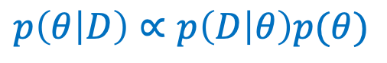
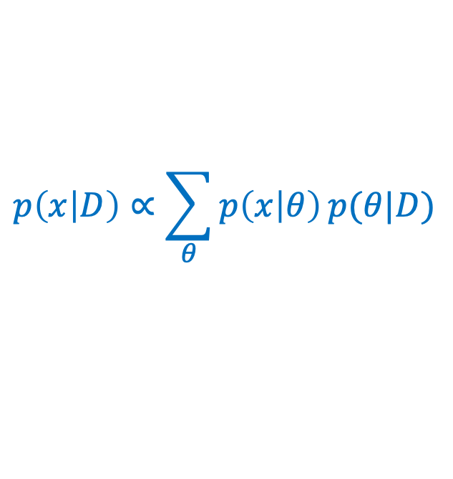
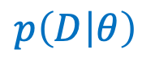
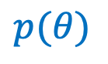
data
learning
posterior
$$p\left(D | θ\right)$$
$$p\left(θ | D\right)∝p\left(D | θ\right)p(θ)$$
prior
model
applications
$$p(θ)$$
$$p\left(x | D\right)∝\sum_{θ}{p\left(x | θ\right)}p(θ|D)$$
trial
design
(for prediction)
actions

Slide 4
data
posterior
machine learning
learning
prior
model
applications
trial
design
actions
scientific inquiry loop
engineering

Slide 5
data
posterior
learning
prior
model
trial
design
actions
agent

Slide 6
observations
sensors
model
goals
prior on
future
observations
actuators
actions
agent

Slide 7
“sensory” data
machine
learning
posterior
goals
prior
model
prior on
future
sensations
trial
design
actions
agent

Slide 8
General framework
Specific example
“sensory” data
data
posterior
machine
learning
posterior
learning
“reward” data
prior
prior
model
model
trial
design
trial
design
actions
actions
agent
agent

Slide 9
compressed
(encoded)
original
decoded

